Slide 1


FANTASTIC 5
Iteration 2
PRESENTATION
11 June, 2024

Slide 2
WELCOME
Content
OVERVIEW
UI DESIGN
TESTING PLAN
INTEGRATION
Information regarding how we are going to proceed forward with our project
11 June, 2024

Slide 3

FANTASTIC 5
Overview
In Iteration 2, we present our final UI design by creating a detailed Canva. Each team member utilized it to enhance and update their web page designs. Additionally, we begin to collaborate with Team 1 and Team 2 to integrate their backend systems with our UI. For the testing phase, our Software Test Document (STD) is significantly updated and detailed, ensuring comprehensive test coverage and improved testing processes. We also did the unit test for the project creation form page and

Slide 4

UI Design
Design Concept: Minimalism and user-friendliness
Inspiration: Apple's design ethos
Key Elements: Clean lines, subtle animations, calming color palette
Tools: Canva
Implement: Updated all page files based on Canva
11 June, 2024

Slide 5
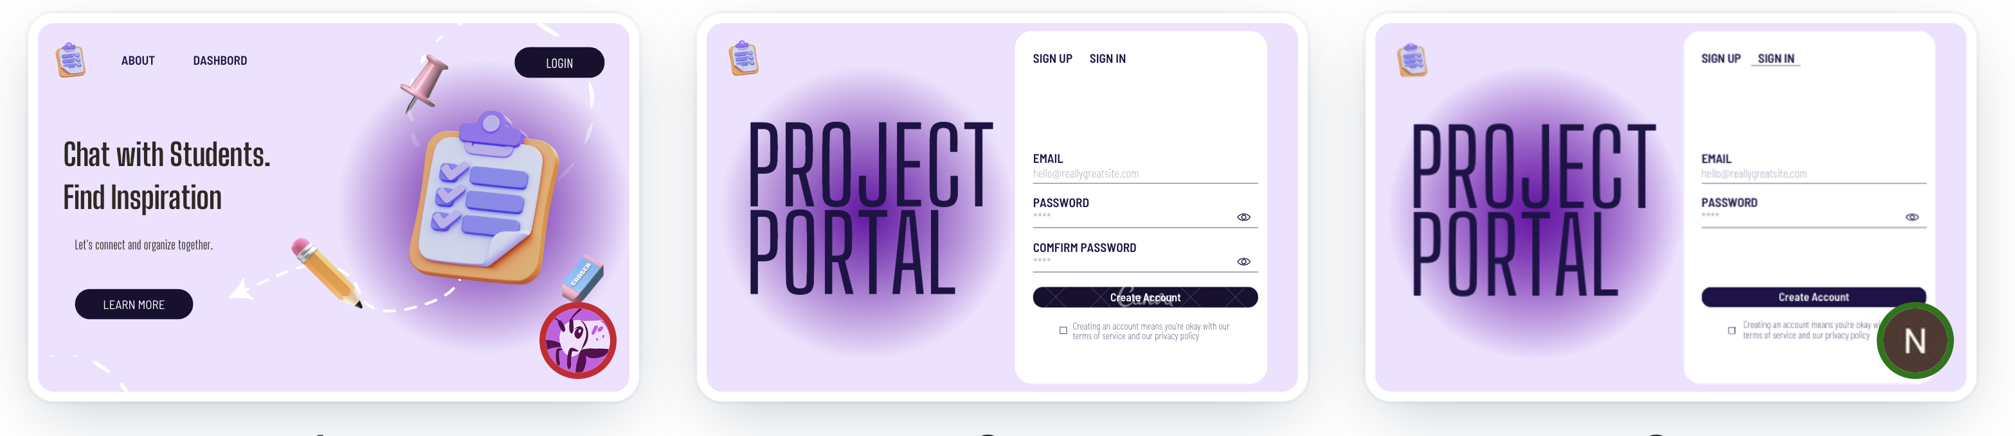
Canva
11 June, 2024

Slide 6
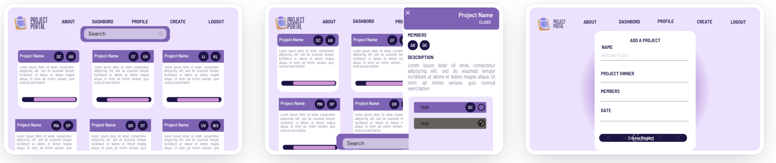
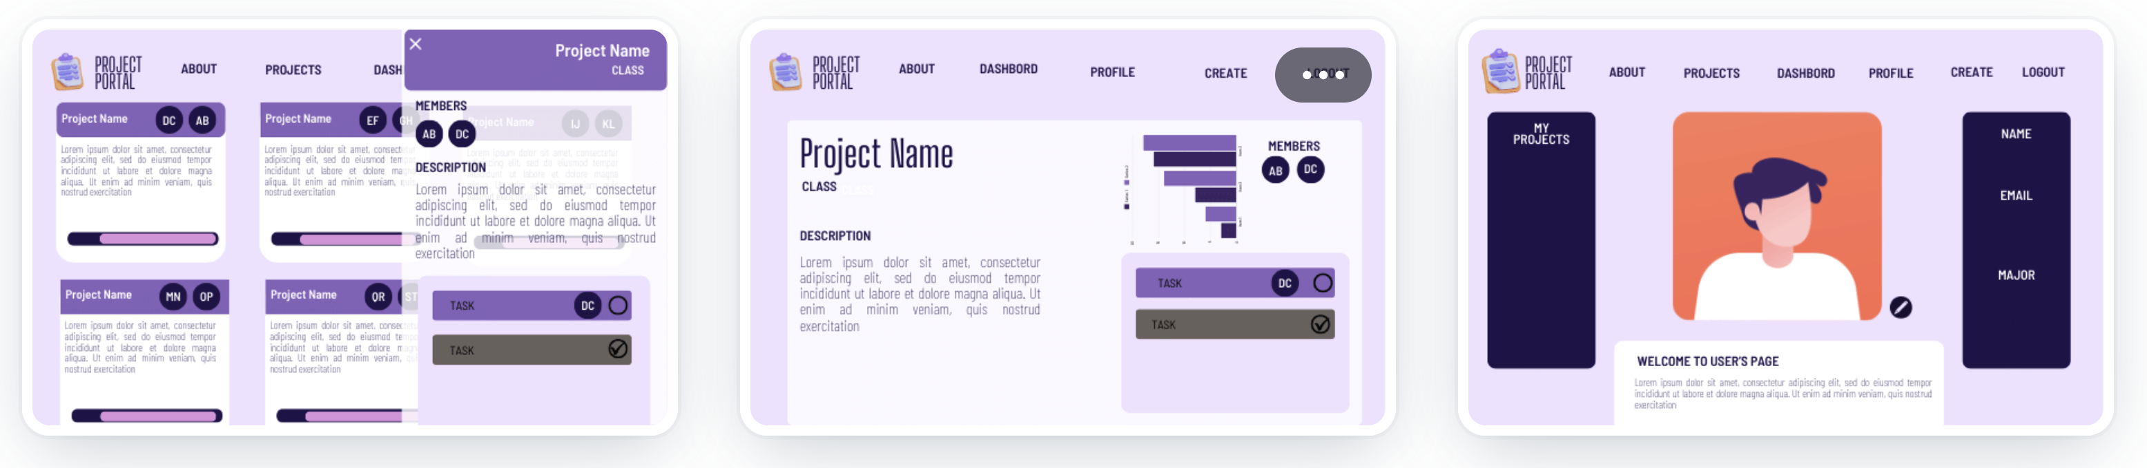
11 June, 2024

Slide 7
Testing Plan
Testing Summary:
Focus on functional and performance requirements.
Includes manual and automated testing.
Test Planning:
Objectives:
Verify user sign-in via Google and email/password.
Ensure correct project display.
Validate project details.
Scope:
Functional and UI testing.
Validation of project details and charts.
Approach:
Manual initial verification.
Automated tests with Python (Behave, Selenium) and Postman.
11 June, 2024

Slide 8
Testing Plan
Unit Testing:
Objectives: Validate individual code units.
Approach: TDD with Jest for React.js.
Smoke Testing:
Objectives: Check critical functionality.
Approach: Automated with Python-Behave-Selenium.
Manual Testing:
Test cases for sign-ins and project displays.
Metrics:
Test Cases: Total written tests.
Coverage: Percentage of functionality tested.
Defect Rate: Defects found vs. total tests.
11 June, 2024

Slide 9
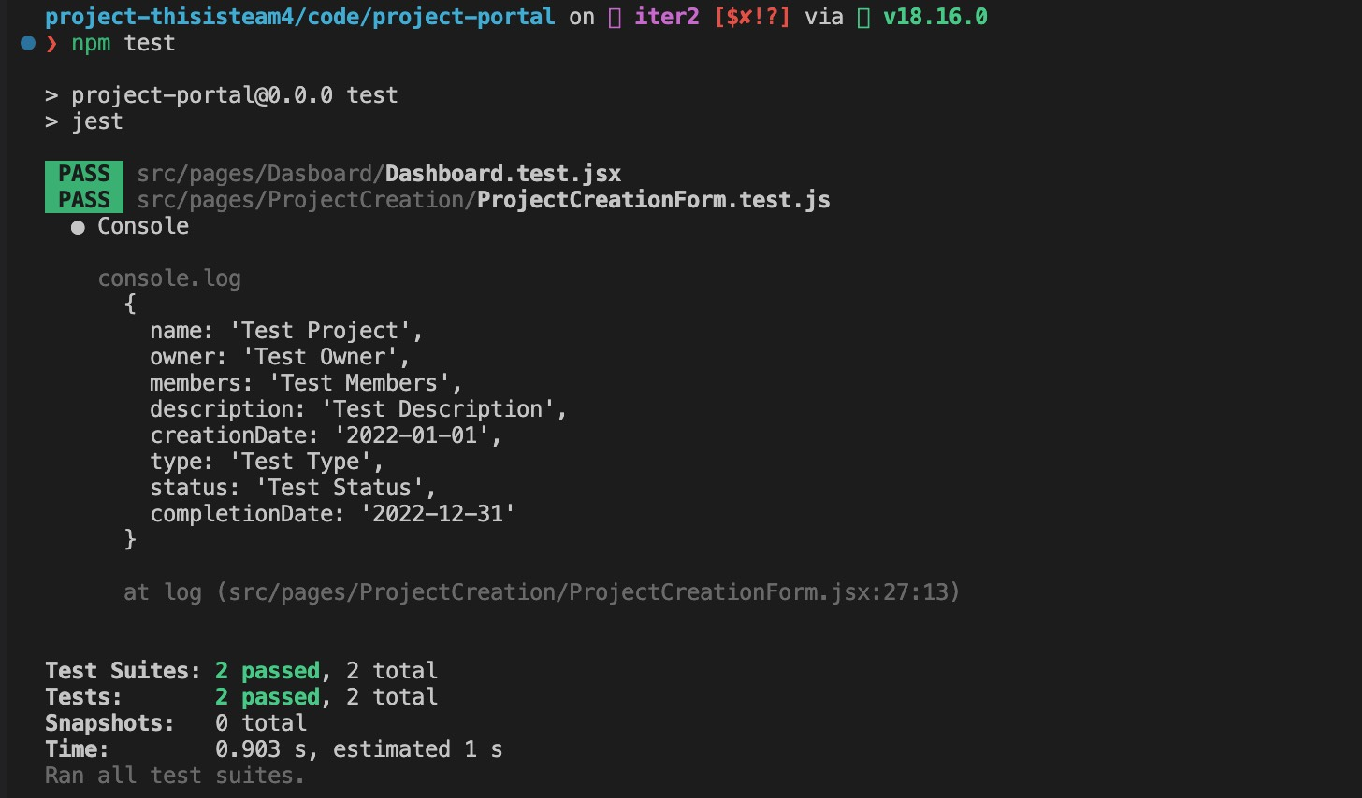
Testing Plan
11 June, 2024

Slide 10
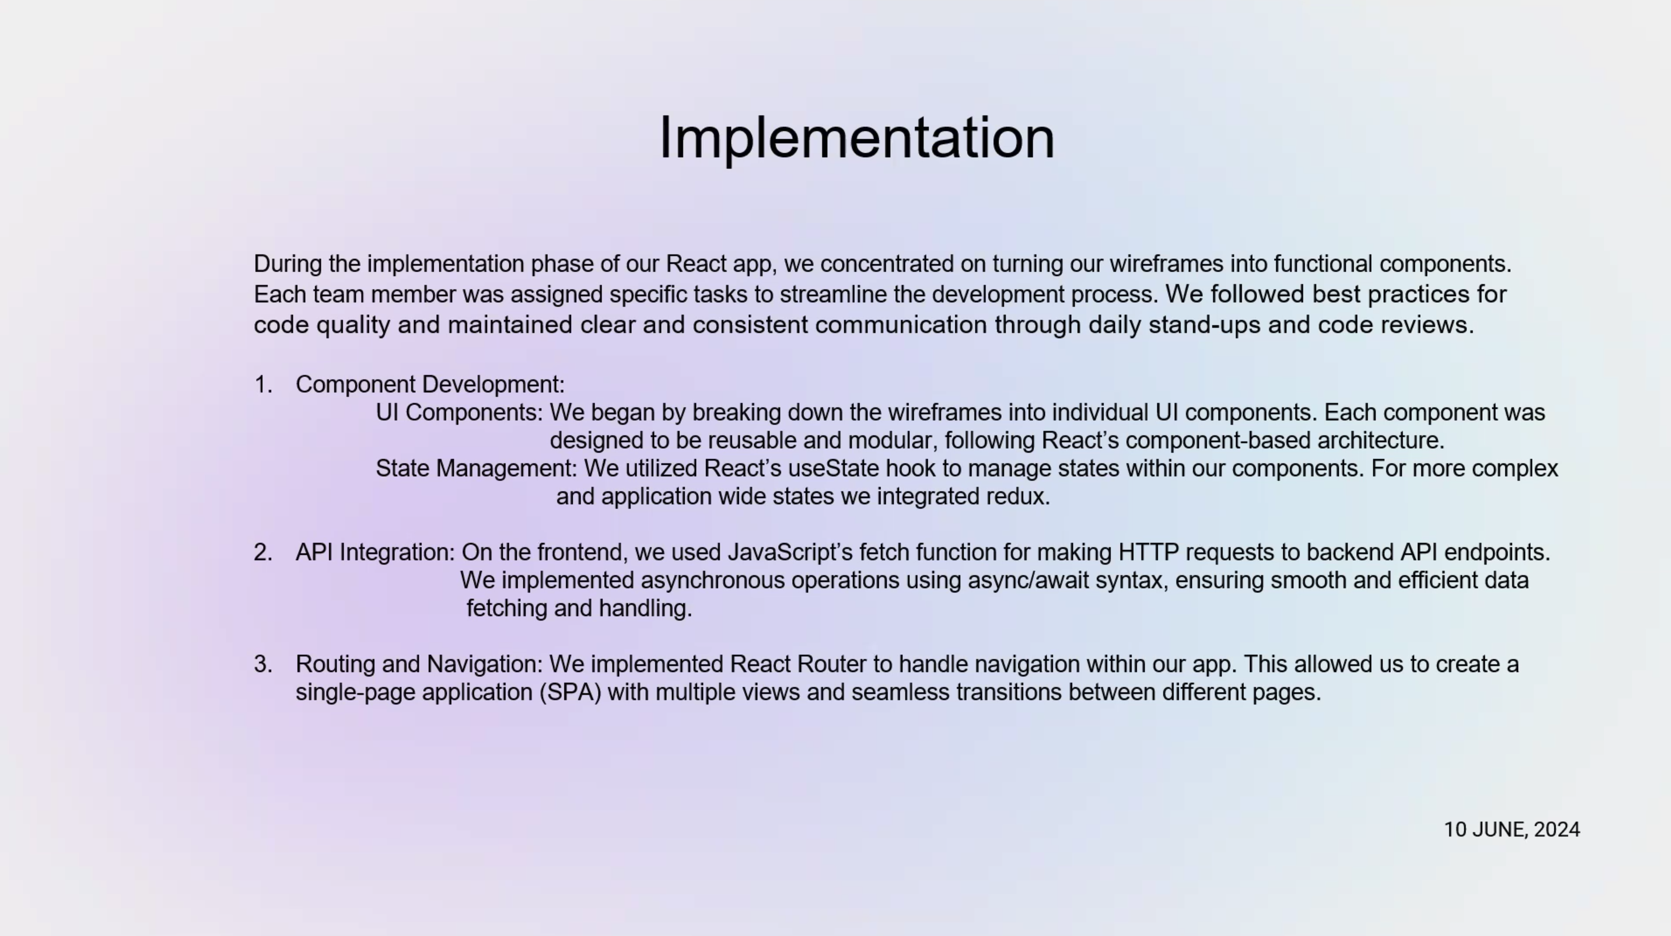

Slide 11
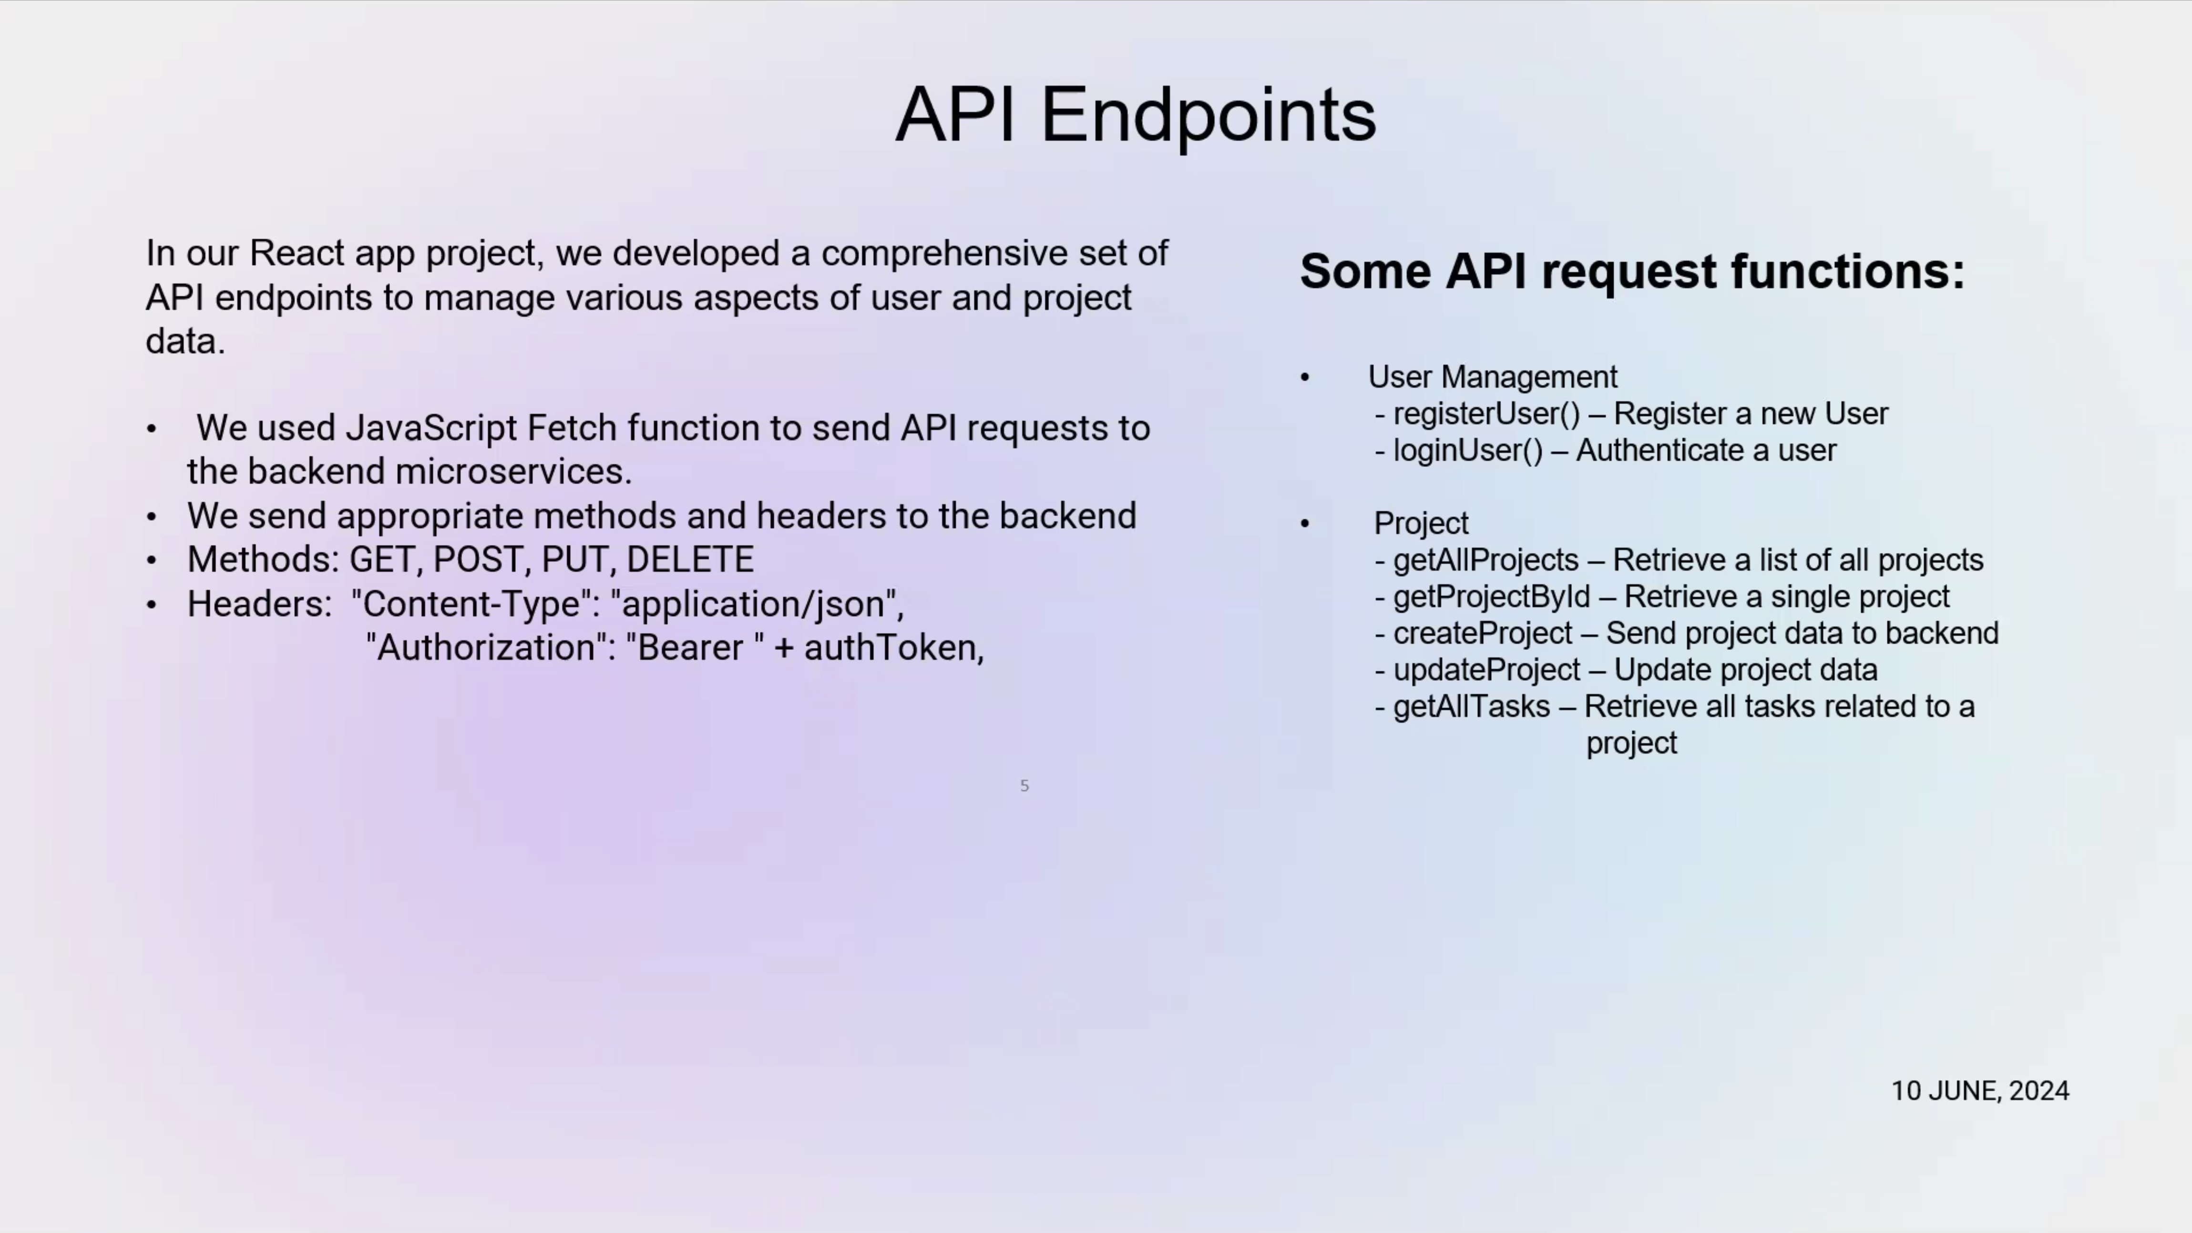

Slide 12
FANTASTIC 5
Thank You
Iteration 2
11 June, 2024

